Slide 1
Database Management System – Day 2

Slide 2
SQL - Advanced Operations
Sub Queries
Transactions
Develop queries using SQL Joins
Introduction to views and indexes
Stored Procedures
Functions
Triggers
Notes:
1

Slide 3



Using a Subquery to Solve a Problem
Who has a salary greater than Abel’s?
Main query:
Which employees have salaries greater than Abel’s salary?
Subquery:
What is Abel’s salary?
Notes:
Using a Subquery to Solve a Problem
Suppose you want to write a query to find out who earns a salary greater than Abel’s salary.
To solve this problem, you need two queries: one to find how much Abel earns, and a second query to find who earns more than that amount.
You can solve this problem by combining the two queries, placing one query inside the other query.
The inner query (or subquery) returns a value that is used by the outer query (or main query). Using a subquery is equivalent to performing two sequential queries and using the result of the first query as the search value in the second query.

Slide 4
Subquery Syntax
  The subquery (inner query) executes once before the main query (outer query).
  The result of the subquery is used by the main query.
SELECT select_list
FROM table
WHERE expr operator
(SELECT select_list
FROM table);
Notes:
Subquery Syntax
A subquery is a SELECT statement that is embedded in a clause of another SELECT statement. You can build powerful statements out of simple ones by using subqueries. They can be very useful when you need to select rows from a table with a condition that depends on the data in the table itself.
You can place the subquery in a number of SQL clauses, including the following:
WHERE clause
HAVING clause
FROM clause
In the syntax:
operator includes a comparison condition such as >, =, or IN
Note: Comparison conditions fall into two classes: single-row operators
(>, =, >=, <, <>, <=) and multiple-row operators (IN, ANY, ALL).
The subquery is often referred to as a nested SELECT, sub-SELECT, or inner SELECT statement. The subquery generally executes first, and its output is used to complete the query condition for the main (or outer) query.

Slide 5
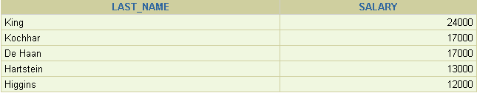
Using a Subquery
SELECT last_name, salary
FROM employees
WHERE salary >
(SELECT salary
FROM employees
WHERE last_name = 'Abel');
11000
Notes:
Using a Subquery
In the slide, the inner query determines the salary of employee Abel. The outer query takes the result of the inner query and uses this result to display all the employees who earn more than this amount.

Slide 6
Guidelines for Using Subqueries
  Enclose subqueries in parentheses.
  Place subqueries on the right side of the comparison condition.
  Use single-row operators with single-row subqueries, and use multiple-row operators with
  multiple-row subqueries.
Notes:
Guidelines for Using Subqueries
A subquery must be enclosed in parentheses.
Place the subquery on the right side of the comparison condition for readability.
With Oracle8i and later releases, an ORDER BY clause can be used and is required in the subquery to perform Top-N analysis.
Before Oracle8i, however, subqueries could not contain an ORDER BY clause. Only one ORDER BY clause could be used for a SELECT statement; if specified, it had to be the last clause in the main SELECT statement.
Two classes of comparison conditions are used in subqueries: single-row operators and
multiple-row operators.

Slide 7
Types of Subqueries
  Single-row subquery
  Multiple-row subquery
Main query
Subquery
returns
ST_CLERK
Main query
Subquery
returns
ST_CLERK
SA_MAN
Notes:
Types of Subqueries
Single-row subqueries: Queries that return only one row from the inner SELECT statement
Multiple-row subqueries: Queries that return more than one row from the inner SELECT statement
Note: There are also multiple-column subqueries, which are queries that return more than one column from the inner SELECT statement. These are covered in the Oracle Database 11g: SQL Fundamentals II course.

Slide 8
Single-Row Subqueries
  Return only one row
  Use single-row comparison operators
Operator | Meaning
= | Equal to
> | Greater than
>= | Greater than or equal to
< | Less than
<= | Less than or equal to
<> | Not equal to
Notes:
Single-Row Subqueries
A single-row subquery is one that returns one row from the inner SELECT statement. This type of subquery uses a single-row operator. The slide gives a list of single-row operators.
Example
Display the employees whose job ID is the same as that of employee 141:
SELECT last_name, job_id
FROM employees
WHERE job_id =
(SELECT job_id
FROM employees
WHERE employee_id = 141);

Slide 9

Executing Single-Row Subqueries
SELECT last_name, job_id, salary
FROM employees
WHERE job_id =
(SELECT job_id
FROM employees
WHERE employee_id = 141)
AND salary >
(SELECT salary
FROM employees
WHERE employee_id = 143);
ST_CLERK
2600
Notes:
Executing Single-Row Subqueries
A SELECT statement can be considered as a query block. The example in the slide displays employees whose job ID is the same as that of employee 141 and whose salary is greater than that of employee 143.
The example consists of three query blocks: the outer query and two inner queries. The inner query blocks are executed first, producing the query results ST_CLERK and 2600, respectively. The outer query block is then processed and uses the values that were returned by the inner queries to complete its search conditions.
Both inner queries return single values (ST_CLERK and 2600, respectively), so this SQL statement is called a single-row subquery.
Note: The outer and inner queries can get data from different tables.

Slide 10
Using Group Functions in a Subquery
SELECT last_name, job_id, salary
FROM employees
WHERE salary =
(SELECT MIN(salary)
FROM employees);
2500
Notes:
Using Group Functions in a Subquery
You can display data from a main query by using a group function in a subquery to return a single row. The subquery is in parentheses and is placed after the comparison condition.
The example in the slide displays the employee last name, job ID, and salary of all employees whose salary is equal to the minimum salary. The MIN group function returns a single value (2500) to the outer query.

Slide 11
The HAVING Clause with Subqueries
  The server executes subqueries first.
  The server returns results into the HAVING clause of the main query.
SELECT department_id, MIN(salary)
FROM employees
GROUP BY department_id
HAVING MIN(salary) >
(SELECT MIN(salary)
FROM employees
WHERE department_id = 50);
2500
Notes:
The HAVING Clause with Subqueries
You can use subqueries not only in the WHERE clause but also in the HAVING clause. The Oracle server executes the subquery, and the results are returned into the HAVING clause of the main query.
The SQL statement in the slide displays all the departments that have a minimum salary greater than that of department 50.
Example
Find the job with the lowest average salary.
SELECT job_id, AVG(salary)
FROM employees
GROUP BY job_id
HAVING AVG(salary) = (SELECT MIN(AVG(salary))
FROM employees
GROUP BY job_id);

Slide 12
What Is Wrong with This Statement?
SELECT employee_id, last_name
FROM employees
WHERE salary =
(SELECT MIN(salary)
FROM employees
GROUP BY department_id);
ERROR at line 4:
single-row subquery returns more than
one row
Single-row operator with multiple-row subquery
Notes:
Errors with Subqueries
One common error with subqueries occurs when more than one row is returned for a single-row subquery.
In the SQL statement in the slide, the subquery contains a GROUP BY clause, which implies that the subquery will return multiple rows, one for each group that it finds. In this case, the result of the subquery are 4400, 6000, 2500, 4200, 7000, 17000, and 8300.
The outer query takes those results and uses them in its WHERE clause. The WHERE clause contains an equal (=) operator, a single-row comparison operator that expects only one value. The = operator cannot accept more than one value from the subquery and, therefore, generates the error.
To correct this error, change the = operator to IN.

Slide 13
Will This Statement Return Rows?
SELECT last_name, job_id
FROM employees
WHERE job_id =
(SELECT job_id
FROM employees
WHERE last_name = 'Haas');
no rows selected
Subquery returns no values.
Notes:
Problems with Subqueries
A common problem with subqueries occurs when no rows are returned by the inner query.
In the SQL statement in the slide, the subquery contains a WHERE clause. Presumably, the intention is to find the employee whose name is Haas. The statement is correct but selects no rows when executed.
There is no employee named Haas. So the subquery returns no rows. The outer query takes the results of the subquery (null) and uses these results in its WHERE clause. The outer query finds no employee with a job ID equal to null, and so returns no rows. If a job existed with a value of null, the row is not returned because comparison of two null values yields a null; therefore, the WHERE condition is not true.

Slide 14
Multiple-Row Subqueries
  Return more than one row
  Use multiple-row comparison operators
Operator | Meaning
IN | Equal to any member in the list
ANY | Compare value to each value returned by the subquery
ALL | Compare value to every value returned by the subquery
Notes:
Multiple-Row Subqueries
Subqueries that return more than one row are called multiple-row subqueries. You use a multiple-row operator, instead of a single-row operator, with a multiple-row subquery. The multiple-row operator expects one or more values:
SELECT last_name, salary, department_id
FROM employees
WHERE salary IN (SELECT MIN(salary)
FROM employees
GROUP BY department_id);
Example
Find the employees who earn the same salary as the minimum salary for each department.
The inner query is executed first, producing a query result. The main query block is then processed and uses the values that were returned by the inner query to complete its search condition. In fact, the main query appears to the Oracle server as follows:
SELECT last_name, salary, department_id
FROM employees
WHERE salary IN (2500, 4200, 4400, 6000, 7000, 8300, 8600, 17000);

Slide 15
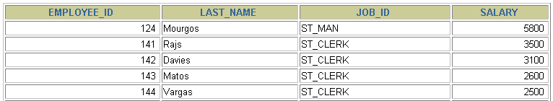
Using the ANY Operator in Multiple-Row Subqueries
SELECT employee_id, last_name, job_id, salary
FROM employees
WHERE salary < ANY
(SELECT salary
FROM employees
WHERE job_id = 'IT_PROG')
AND job_id <> 'IT_PROG';
9000, 6000, 4200
…
Notes:
Multiple-Row Subqueries (continued)
The ANY operator (and its synonym, the SOME operator) compares a value to each value returned by a subquery. The slide example displays employees who are not IT programmers and whose salary is less than that of any IT programmer. The maximum salary that a programmer earns is $9,000.
<ANY means less than the maximum. >ANY means more than the minimum. =ANY is equivalent to IN.

Slide 16
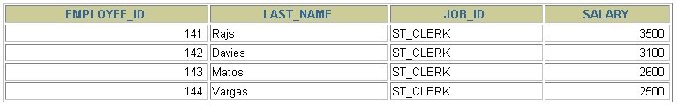
Using the ALL Operator in Multiple-Row Subqueries
SELECT employee_id, last_name, job_id, salary
FROM employees
WHERE salary < ALL
(SELECT salary
FROM employees
WHERE job_id = 'IT_PROG')
AND job_id <> 'IT_PROG';
9000, 6000, 4200
Notes:
Multiple-Row Subqueries (continued)
The ALL operator compares a value to every value returned by a subquery. The slide example displays employees whose salary is less than the salary of all employees with a job ID of IT_PROG and whose job is not IT_PROG.
>ALL means more than the maximum, and <ALL means less than the minimum.
The NOT operator can be used with IN, ANY, and ALL operators.

Slide 17
Null Values in a Subquery
SELECT emp.last_name
FROM employees emp
WHERE emp.employee_id NOT IN
(SELECT mgr.manager_id
FROM employees mgr);
no rows selected
Notes:
Returning Nulls in the Resulting Set of a Subquery
The SQL statement in the slide attempts to display all the employees who do not have any subordinates. Logically, this SQL statement should have returned 12 rows. However, the SQL statement does not return any rows. One of the values returned by the inner query is a null value, and, therefore, the entire query returns no rows.
The reason is that all conditions that compare a null value result in a null. So whenever null values are likely to be part of the results set of a subquery, do not use the NOT IN operator. The NOT IN operator is equivalent to <> ALL.
Notice that the null value as part of the results set of a subquery is not a problem if you use the IN operator. The IN operator is equivalent to =ANY. For example, to display the employees who have subordinates, use the following SQL statement:
SELECT emp.last_name
FROM employees emp
WHERE emp.employee_id IN
(SELECT mgr.manager_id
FROM employees mgr);

Slide 18
“Exists” Construct
The Exists operator tests for existence of rows in the result of the subquery
If found the search does not continue in the inner query and the condition flags a TRUE
If not found, the condition flags FALSE and search continues in the inner query

Slide 19
“Exists” Construct
Example : To find employees who have atleast one person reporting to them
  Select employee_id, last_name, job_id, department_id from employees outer
  where exists (select ‘X’
  from employees
  where manager_id=outer.employee_id)
  Note : X here is a constant used, since the inner query does not return any specific value. Also the performance becomes faster with a constant than a column

Slide 20
“Exists” Construct
Alternatively we can use in keyword for the Exists operator
  Select employee_id, last_name, job_id, department_id from employees
  where employee_id in (select manager_id
  from employees
  where manager_id is not null)

Slide 21
“Exists” Construct
Find all departments that do not have any employees
select department_id, department_name
From departments d
where not exists (select ‘X’
from employees
where department_id=d.department_id)
Alternatively , use not in keyword

Slide 22
Joins
To avoid cartesian products as a result of query from multiple tables, we use Joins.
Joins are conditions that are applied in a where clause.
Joins are of various types
  Equijoin / Natural Joins
  Non Equijoin
  Self Join
  Cross Join
  Inner Joins
  Outer Joins

Slide 23
Joins
Equijoins : This type of a Join mostly involves Primary and foreign key compliments with a = operator
  Select employee.employee_id, employee.first_name, employee.last_name,departments.department_id from
  employee,departments
  where employee.department_id=departments.department_id
Non Equijoins : This type of a join is used when we do not use = operator
  Select e.last_name,e.salary,j.grade_level
  from employee e, job_grade j
  where e.salary between j.lowest_sal and j.highest_sal
Self joins : This type of join is used to join a single table with itself
  Select e1.last_name || ‘works for’ || e2.last_name
  from employee e1, employee e2
  where e1.manager_id=e2.employee_id

Slide 24
Joins
Cross Join : This is used to produce cartesian products
  Select last_name,department_name
  from employees,department (or)
  Select last_name,department_name
  from employees
  Cross join departments

Slide 25
Joins
Inner Joins : Similar to Equi/natural joins that returns only matched records
  Left Outer Join
    A join between 2 tables that returns the results of the inner join as well as unmatched rows from the left table
    Eg : select e.last_name, e.department_id,d.department_name
    from employee e left outer join departments d
    on (e.department_id=d.department_id)

Slide 26
Joins
  Right Outer Join
    A join between 2 tables that returns the results of the inner join as well as unmatched rows from the right table
    Eg : select e.last_name, e.department_id,d.department_name
    from employee e right outer join departments d
    on (e.department_id=d.department_id)

Slide 27
Joins
  Full Outer Join :
    A join between 2 tables that returns the results of the inner join as well as the results of a left and right join
    Eg : select e.last_name, e.department_id,d.department_name
    from employee e full outer join departments d
    on (e.department_id=d.department_id)

Slide 28
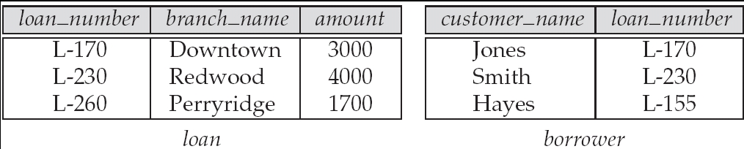
Joined Relations – Datasets for Examples
Relation loan
Relation borrower
Note: borrower information missing for L-260 and loan information missing for L-155

Slide 29
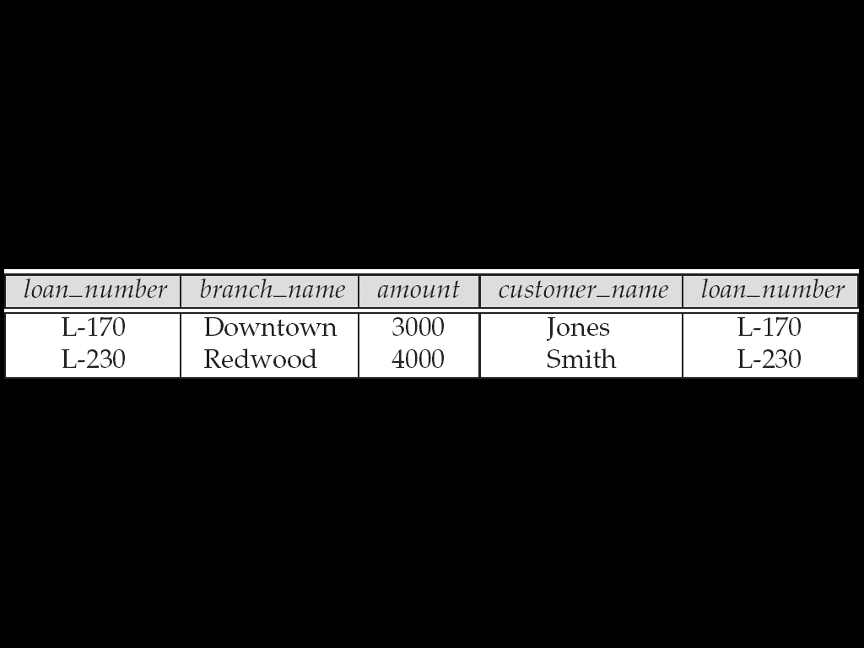
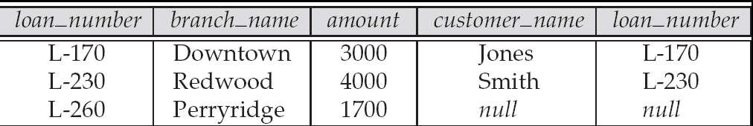
Joined Relations – Examples
loan inner join borrower on
loan.loan_number = borrower.loan_number
loan left outer join borrower on
loan.loan_number = borrower.loan_number

Slide 30
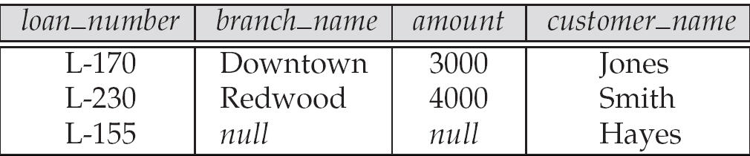
Joined Relations – Examples
loan natural inner join borrower
loan natural right outer join borrower

Slide 31
Transaction Management
A Database transaction consists of one of the following
  DML Statement/s which constitutes one consistent change
  One DDL statement
  One DCL statement
  Begins when the first DML statement is executed
  Ends with one of the following events
    A Commit or a Rollback statement
    A DDL or a DCL statement executed(auto commit)
    The user exits
    The system crashes

Slide 32
Transaction Management
With Commit and Rollback statements, one can ensure
  Data Consistency
  Preview data changes before making changes permanent
  Group logically related operations
Save Points
  Are logical blocks/markers of set operations in a transaction.
  It is not ANSI standard SQL

Slide 33
Controlling Transactions
Time
Transaction
Delete
SavePoint A
Insert
Update
Savepoint B
Insert
Rollback to savepoint B
Rollback to savepoint A
Rollback

Slide 34
State of Data before Commit or Rollback
The previous state of the data can be recovered
The current user can review the results using select statements
Other users cannot view the results of the DML statements by the current user
The affected rows are locked. Other users cannot change the data

Slide 35
A sample Transaction
BEGIN
UPDATE emp_information
SET emp_dept='Web Developer‘
WHERE emp_name='Saulin';
COMMIT;
END;

Slide 36
Sample
Begin
insert into emp (empno,ename,sal) values (109,’Sami’,3000);
save transaction a;
insert into dept values (10,’Sales’,’Hyd’);
save transaction b;
insert into salgrade values (‘III’,9000,12000);
rollback to a;
  Then row from salgrade table and dept will be roll backed. At this point you can commit the row inserted into emp table or rollback the transaction.
rollback to b;
Then row inserted into salgrade table will be roll backed. At this point you can commit the row inserted into dept table and emp table or rollback to savepoint a or completely roll back the transaction.
rollback;
Then the whole transactions is roll backed.
commit;
Then the whole transaction is committed and all savepoints are removed.
End

Slide 37
Introduction to views
A relation that is not of the conceptual model but is made visible to a user as a “virtual relation” is called a view.
A view is defined using the create view statement which has the form
create view v as < query expression >
where <query expression> is any legal SQL expression. The view name is represented by v.
Once a view is defined, the view name can be used to refer to the virtual relation that the view generates.

Slide 38
Example Queries
A view consisting of branches and their customers
create view all_customer as
(select branch_name, customer_name
from depositor, account
where depositor.account_number =
account.account_number )
union
(select branch_name, customer_name
from borrower, loan
where borrower.loan_number = loan.loan_number )
Find all customers of the Perryridge branch
select customer_name
from all_customer
where branch_name = 'Perryridge'

Slide 39
Uses of Views
Hiding some information from some users
  Consider a user who needs to know a customer’s name, loan number and branch name, but has no need to see the loan amount.
  Define a view
  (create view cust_loan_data as
  select customer_name, borrower.loan_number,
  branch_name
  from borrower, loan
  where borrower.loan_number = loan.loan_number )
  Grant the user permission to read cust_loan_data, but not borrower or loan

Slide 40
Processing of Views
When a view is created
  the query expression is stored in the database along with the view name
  the expression is substituted into any query using the view
Views definitions containing views
  One view may be used in the expression defining another view
  A view relation v₁ is said to depend directly on a view relation v₂ if v₂ is used in the expression defining v₁
  A view relation v is said to be recursive if it depends on itself.

Slide 41
Update of a View
Create a view of all loan data in the loan relation, hiding the amount attribute
create view loan_branch as
select loan_number, branch_name
from loan
Add a new tuple to loan_branch
insert into loan_branch
values ('L-37‘, 'Perryridge‘)
This insertion must be represented by the insertion of the tuple
('L-37', 'Perryridge', null )
into the loan relation

Slide 42
Updates Through Views (Cont.)
Some updates through views are impossible to translate into updates on the database relations
  create view v as
  select loan_number, branch_name, amount
  from loan
  where branch_name = ‘Perryridge’
insert into v values ( 'L-99','Downtown', '23')
Others cannot be translated uniquely
Most SQL implementations allow updates only on simple views (without aggregates) defined on a single relation

Slide 43
Introduction to Indexes
Without indexes, any query or data modification causes the SQL engine to search the referenced tables from the top down. This is akin to searching for a piece of information in a book by reading it from page 1. A single well-placed index can shorten your query time from dozens of minutes to under a second.

Slide 44
Understanding Indexes

Slide 45
Introduction to Indexes
All SQL Server indexes are B-Trees. There is a single root page at the top of the tree, branching out into N number of pages at each intermediate level until it reaches the bottom, or leaf level, of the index
Why to Create an Index
  Speeds up data access
  Enforces uniqueness of rows
Why Not to Create an Index
  Consumes disk space
Notes:
45
Introduction
Creates an index on a given table; this statement either changes the physical ordering of the table or provides the optimizer with a logical ordering of the table to increase query efficiency. When an index is created for the primary key, use the table- and column-level PRIMARY KEY constraints by specifying the PRIMARY KEY keywords provided with either the CREATE TABLE or ALTER TABLE statements.
Only the table owner can create indexes on that table. The owner of a table can create an index at any time, whether or not there is data in the table. Indexes can be created on tables in another database by specifying a qualified database name.
Syntax
CREATE [UNIQUE] [CLUSTERED | NONCLUSTERED]
INDEX index_name ON table (column [,...n])
[WITH
[PAD_INDEX]
[[,] FILLFACTOR = fillfactor]
[[,] IGNORE_DUP_KEY]
[[,] DROP_EXISTING]
[[,] STATISTICS_NORECOMPUTE]
]
[ON file group]
An INDEX is created using the CREATE INDEX command.
45

Slide 46


How SQL Server Accesses Data
Table scan
  SQL Server reads all table pages
Index
  SQL Server uses index pages to find rows
Notes:
SQL Server accesses data in one of two ways:
By scanning all the data pages in a table—called a table scan. When SQL Server
performs a table scan, it:
1. Starts at the beginning of the table.
2. Scans from page to page through all the rows in the table.
3. Extracts the rows that meet the criteria of the query.
By using indexes. When SQL Server uses an index, it:
1. Traverses the index tree structure to find rows that the query requests.
2. Extracts only the needed rows that meet the criteria of the query.
SQL Server first determines whether an index exists. Then the query optimizer—the
component responsible for generating the optimal execution plan for a query—
determines whether scanning a table or using the index is more efficient for accessing
data.
46

Slide 47
Work of Indexes
An Index contains a collection of keys and pointers. Keys are values built from one or more columns in the table with the key is associated.
the column on which the key is associated.
The column on which the key is built is the one on which the data is frequently searched.
The pointers store the address of the storage location where a data page is stored in the memory.
when the users query data with condition based on key columns, the query processor scans the indexes, retrieves the address of the data page where the required data is stored in the memory. And access the information. the query processor does not need to search for data in all the data pages. Therefore the query execution time is reduced

Slide 48
Using Clustered Indexes
A clustered index determines the physical order of data in a table. A clustered index is analogous to a telephone directory, which arranges data by last name .
Each table can have only one clustered index
Notes:
48
Types Of Index
Indexes are of two types:
Clustered Index
Non Clustered Index
Clustered Index
A clustered index actually stores the data records in physical order. Because a table can only be physically sorted in one order, a table can only define one clustered index. Having a clustered index also means that each time a record is inserted or deleted from a table, the table or at least parts of the table must be rewritten to maintain the physical order. Even an update to the key field of a clustered index causes the table to delete the 'old' record and then insert the 'new' record. Obviously maintaining the physical order of the records in a table can be quite expensive, especially if there are frequent updates to the table. However, if the table is used mostly for retrieval and reporting, the advantages of a clustered index come to the forefront.
Clustered Index are suitable for :
Columns that contain a limited number of distinct values, such as a state column that contains only 50 distinct state codes.
Queries that return a range of values using operators such as BETWEEN, >, >=, <, and <=.
48

Slide 49

What Is a Clustered Index?
One clustered index per table
B-tree stores data pages in order of index key
sys.partitions
id | index_id = 1 |  | root_page
Root Index Page
Intermediate Level
Index Pages
…
…
Leaf Nodes
Data Pages
…
…
Notes:
A clustered index sorts and stores the data rows of the table in order based on the
clustered index key. The clustered index is implemented as a B-tree. Each page in a Btree is called an index node. The top node of the B-tree is called the root node. The
bottom level of nodes in the index is called the leaf level. Any index levels between the root node and the leaf nodes are collectively known as intermediate nodes. Each page in the intermediate or bottom levels has a pointer to the preceding and subsequent pages, forming a doubly linked list. This structure provides a highly efficient mechanism to speed the process of locating data.
Clustered indexes are most effective when used to support queries that do the following:
■ Return a range of values by using operators such as BETWEEN, >, >=, <, and <=.
Because the table data is physically stored in index order, after the row with the first value is found by using the clustered index, rows with subsequent indexed values are guaranteed to be physically adjacent.
■ Return data sorted using the ORDER BY or GROUP BY clause. An index on the
columns specified in the ORDER BY or GROUP BY clause might remove the need
for the database engine to sort the data because the rows are already sorted. This
improves query performance.
■ Return data combined by using JOIN clauses; typically these are foreign key
columns.
■ Return large result sets.
49

Slide 50
Guidelines for Clustered Indexes
Heavily Updated Tables
  A clustered index with an identity column keeps updated pages in memory.
Sorting
  A clustered index keeps the data pre-sorted
Column Length and Data Type
  Limit the number of columns
  Reduce the number of characters
  Use the smallest data type possible
Columns that contain a large number of distinct values.
Queries that return a range of values using operators such as BETWEEN, >, >=, <, and <=.
Notes:
50
Query performance is dependent on how well you have designed your indexes.
Writing Good Search Arguments
If an expression does not limit a search, it is considered a non-search argument. You should rewrite queries to convert non-search arguments into
search arguments.
To limit the search, you should:
Specify a WHERE clause in the query.
Verify that the WHERE clause limits the number of rows.
Verify that an expression exists for every table referenced in the query.
Avoid using leading wildcard characters.
Note : Query performance relies on how well you design your indexes and how selective your queries are.
50

Slide 51
Using Nonclustered Indexes
A nonclustered index is analogous to an index in a textbook. The data is stored in one place, the index in another, with pointers to the storage location of the data.
Nonclustered Indexes Are the SQL Server Default
Existing Nonclustered Indexes Are Automatically Rebuilt When:
  An existing clustered index is dropped
  A clustered index is created
  The DROP_EXISTING option is used to change which columns define the clustered index
  If no clustered index is created on the table, the rows are not guaranteed to be in any particular order.
Notes:
51
NonClustered Indexes
A nonclustered index creates a separate 'internal' table that stores only the selected key values of the table in order. Each 'record' in this index contains the key value from one record in the table along with a pointer to either the data record itself or to a value in the clustered index. Because a nonclustered index does not require a physical sorting of the actual data, we can have as many nonclustered indexes associated with a single table as possible. The maximum limit is 249. For each insert, delete, and update performed, SQL updates the table.
Nonclustered Indexes are suitable for:
Columns that contain a high number of distinct values, such as a combination of last name and first name (if a clustered index is used for other columns).
Queries that do not return large result sets.
Columns frequently involved in search conditions of a query (WHERE clause) that return exact matches.
Decision Support System applications for which joins and grouping are frequently required.
51

Slide 52
What Is a Nonclustered Index?
B-tree references underlying heap or clustered index
Up to 249 nonclustered indexes per table
sys.partitions
id | index_id > 1 |  | root_page
Root Index Page
Leaf Nodes
Index Pages
…
…
Heap or
Clustered
Index
Data Pages
…
…
Notes:
Nonclustered indexes have the same B-tree structure as clustered indexes except that the data rows of the underlying table are not sorted and stored in order based on their nonclustered keys. In the nonclustered index, the data and the index are stored separately, and the leaf level of the index consists of index pages instead of data pages.
Note: Columns with the following data types cannot be used as the key in a nonclustered index: ntext, text, varchar(max), nvarchar(max), varbinary(max), xml, or image.
Consider using a nonclustered index when:
■ You want to improve the performance of queries that use JOIN or GROUP BY clauses. You should create multiple nonclustered indexes on columns involved in the join and grouping operations and a clustered index on any foreign key columns.
■ Your table has low update frequency but contains large volumes of data—for example, a decision support application. Such applications contain large amounts of primarily read-only data and can benefit significantly from many nonclustered indexes. With many indexes, the query optimizer has more indexes to choose from to determine the fastest access method, and the low update characteristics of the database mean that index maintenance is unlikely to impede performance.
■ You know that your queries do not return large result sets.
■ You need to index columns that are frequently involved in search conditions of a
Query such as a WHERE clause.
■ You need to index columns that contain many distinct values, such as a combination of last name and first name. Nonclustered indexes work best on columns in which the data selectivity ranges from highly selective to unique
52

Slide 53
Creating Unique Indexes
Duplicate key values are not allowed when a new row is added to the table
Composite index can also be created on more than one columns in a table
USE Northwind
CREATE UNIQUE NONCLUSTERED INDEX
ixn_custindex_customers_CustID
ON CUSTOMERS(CustomerID)
USE Northwind
CREATE UNIQUE NONCLUSTERED INDEX U_OrdID_ProdID
ON [ORDER DETAILS] (OrderID, ProductID)
Notes:
53
53

Slide 54
Creating Indexes on Computed Columns
You Can Create Indexes on Computed Columns When:
Computed_column_expression is deterministic and precise
ANSI_NULL connection-level option is ON
Computed column cannot evaluate to the text, ntext, or image data types
Required SET options are set ON when you create the index and when INSERT, UPDATE, or DELETE statements change the index value
NUMERIC_ROUNDABORT option is set OFF
Notes:
54
Create Indexes on Computed Columns
- Computed_column_expression is deterministic and precise
- ANSI_NULL connection-level option is ON
- Computed column cannot evaluate to the text, ntext, or image data types
- Required SET options are set ON when you create the index and when INSERT, UPDATE, or DELETE statements change the index value
- NUMERIC_ROUNDABORT option is set OFF
Query Optimizer May Ignore an Index on a Computed Column
54

Slide 55
Creating and Dropping Indexes
Using the CREATE INDEX Statement
  Indexes are created automatically on tables with PRIMARY KEY or UNIQUE constraints
  Indexes can be created on views if certain requirements are met
Using the DROP INDEX Statement
USE Northwind
CREATE CLUSTERED INDEX ixc_lnmindex_employees_lastname
ON employees(lastname)
USE Northwind
DROP INDEX ixc_lnmindex_employees_lastname on employees
Notes:
55
Creating Indexes
Example:
Create NonClustered Index Cl_Salary on Employee (Salary)
Drop Index:
Example:
USE Northwind
DROP INDEX employees.CL_lastname
Note:
Only the owner of the table can create indexes on the same table.
If CLUSTERED is not specified, a non clustered index is created.
Index names must be unique within a table but need not be unique within a database.
Index names must follow the rules of identifiers.
55

Slide 56
Indexing Guidelines
Columns to Index
  Primary and foreign keys
  Those frequently searched in ranges
  Those frequently accessed in sorted order
  Those frequently grouped together during aggregation
Columns Not to Index
  Those seldom referenced in queries
  Those that contain few unique values
  Those defined with text, ntext, or image data types
Notes:
56
Columns to Index
Create indexes on frequently searched columns, such as:
Primary keys.
Foreign keys or columns that are used frequently in joining tables.
Columns that are searched for ranges of key values.
Columns that are accessed in sorted order.
Columns that are grouped together during aggregation.
Columns Not to Index
Do not index columns that:
You seldom reference in a query.
Contain few unique values. For example, an index on a column with two
values, male and female, returns a high percentage of rows.
Are defined with text, ntext, and image data types. Columns with these datatypes cannot be indexed.
56

Slide 57
Guidelines for Non-Clustered Index
Columns that contain a large number of distinct values.
Queries that do not return large result sets. Columns frequently involved in search conditions of a query (WHERE clause) that return exact matches.
Decision-support-system applications for which joins and grouping are frequently required.
Create multiple nonclustered indexes on columns involved in join and grouping operations, and a clustered index on any foreign key columns.
Covering all columns from one table in a given query.
Notes:
57
57

Slide 58
Types of Indexes
There are kinds of indexes :
  b*tree indexes - OLTP application
  reverse key indexes – Oracle Real Application Clusters (RAC)
  bitmap indexes – Datawarehouse applications
  function-based indexes - SQL and user defined functions
  domain indexes – User defined datatypes

Slide 59
When to create Indexes
A Column contains wide range of values
A column contains large number of null values
One or more columns are frequently used together in where clause or join condition
The table is large and most queries are expected to retrieve less than 2 to 4 % of rows

Slide 60
When not to create a Index
The table is small
The columns are not often used as a condition in a query
The table is updated frequently
More than 2 to 4 % of rows are retrieved on queries

Slide 61
Usage
Create Index Ind1
on employees(lastname)
Create Index Ind2
  on employees(Ecode, last_name)
Drop Index <index name> on <tablename>

